Slide 1


Month 20XX
Signalling vs Human Capital
*The* most important debate in Economics of Education
Jeff Denning

Slide 2

Introduction
A fact in all economies of which I’m aware: people with more education are less likely to be unemployed, earn more money, etc.
Why?

Slide 3

What is Human Capital?
Any skill that is valued in the labor market.
Examples? Lebron James at basketball. Welder. HVAC Technician. 3rd Grade Teacher. Model
We all are endowed with some human capital.
How do you acquire human capital?
Only education?
Side bar: What is Capital?
Bulldozer, Truck, etc
What are some differences in capital versus human capital?

Slide 4
Human Capital vs. Capital
Similarities
Require Investment
Rate of Return
Risk
Differences
Cannot be collateralized
Can’t be transferred

Slide 5
Why is this Useful?
A simple model for educational benefit
When do you go to school?
When the benefits of another year of schooling exceed the costs

Slide 6
Signalling
Spence 1973, “Job Market Signalling” is the classic reference on job market signalling
He won a Nobel prize for his work, which was largely given for this paper
This model is radically different in mechanisms but quite similar in empirical content—people with more education make more money

Slide 7
Model
Schooling is worthless but hard
More productive workers find schooling easier (less costly to acquire)
Who gets schooling in this case?
The productive workers do and the less productive do not

Slide 8
How could you test?

Slide 9
How could you test?
Keep signal the same, vary the human capital
Learn more or less in your degree
Keep human capital the same, vary the signal
Randomly give out degrees

Slide 10
Case Study
Los Andes, top university in Colombia reduced coursework for their degree
In Econ and Business, they got rid of required courses (after students had already decided to enroll)

Slide 11
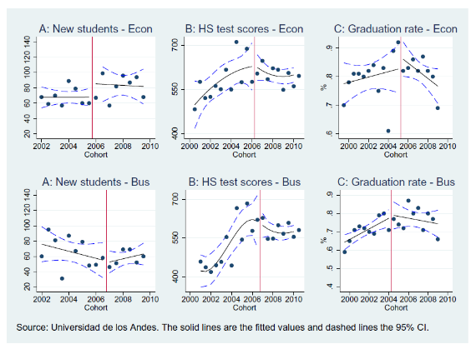
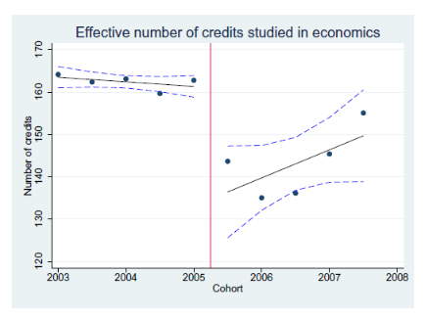
What changed?

Slide 12
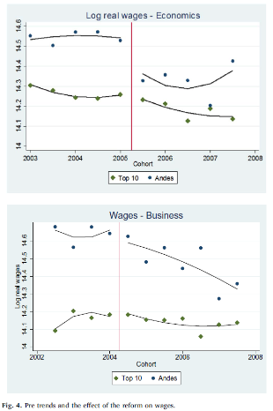
A Win for Human Capital

Slide 13
Why does this matter?
If the world is about signaling, should the government invest in education?
What implications do elite colleges have for equity in both worlds?

